Slide 1
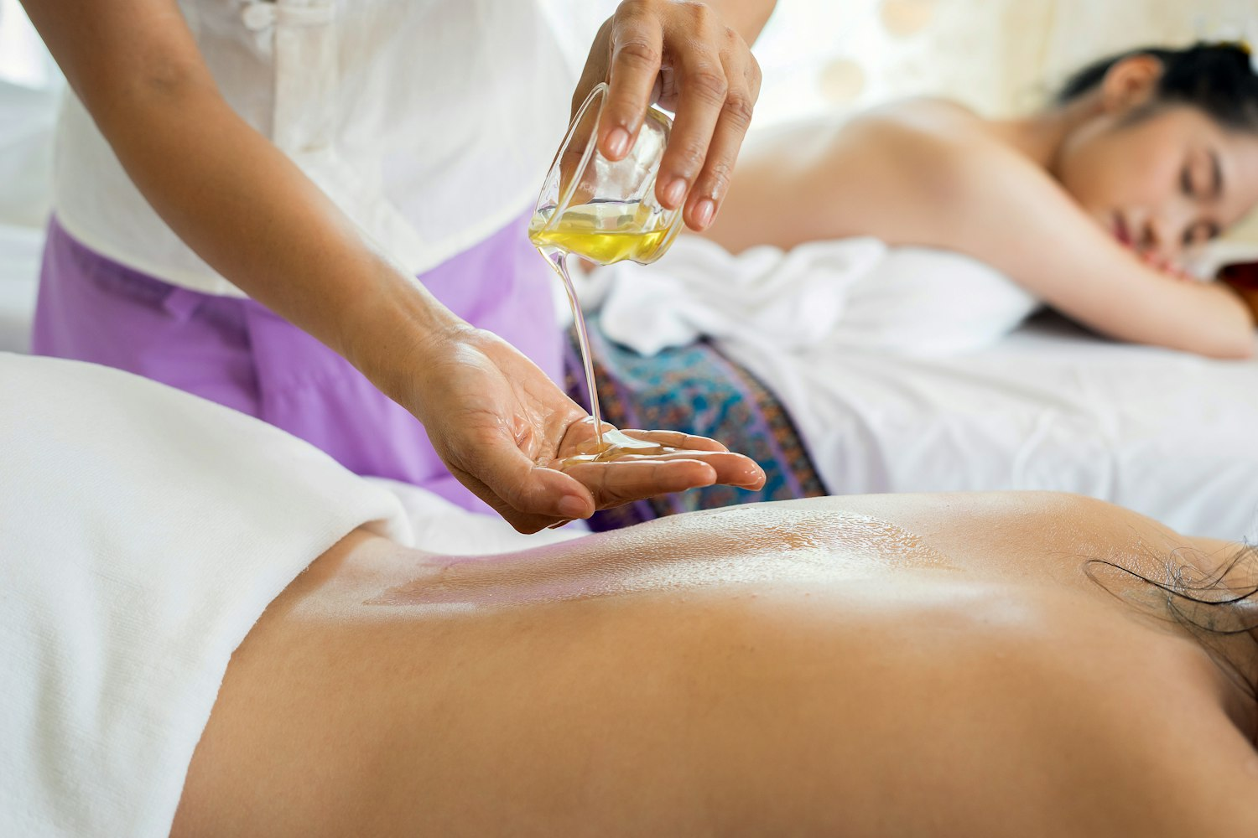


SPA & WELLNESS
The Art of Spa Etiquette
A professional standard of presence, care, and grace for our licensed massage therapists.
FORBES TRAVEL GUIDE FIVE-STAR SERVICE
Notes:
Welcome to Sea Island. Today is about the quiet, deliberate behaviors that make a treatment feel five-star. Set a gracious, calm tone.

Slide 2

WHY IT MATTERS
Etiquette shapes every guest’s experience
Guest Satisfaction
Team Harmony
Career Growth
Guests remember how they were made to feel long after they leave.
Shared standards keep a busy floor calm, fair, and dependable.
Polish is noticed — it earns rebookings, referrals, and advancement.
Notes:
Etiquette is not stiffness — it is the quiet infrastructure behind happy guests, a calm team, and your own growth. Connect each to their daily reality.

Slide 3
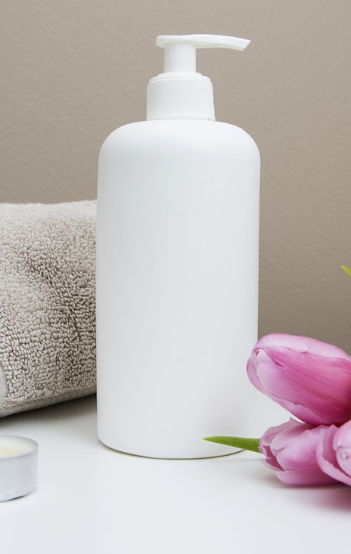
THE SESSION
Today’s Agenda
01
Introduction & Overview
02
Professional Presence & Communication
03
Treatment Room Etiquette
04
Spa Environment & Team Etiquette
05
Guest Experience Scenarios
06
Wrap-Up & Assessment
Notes:
A quick map of the four hours: six modules, building from the individual outward to the team and the guest.

Slide 4

BY THE END OF TODAY
Learning Objectives
01
Define spa etiquette and why it matters in professional practice.
02
Communicate professionally with guests and colleagues.
03
Apply etiquette to room prep, guest service, and collaboration.
04
Handle challenges with poise while maintaining etiquette.
Notes:
By the end of today, here is what you will be able to do. These are the outcomes we assess in the closing role-play.

Slide 5
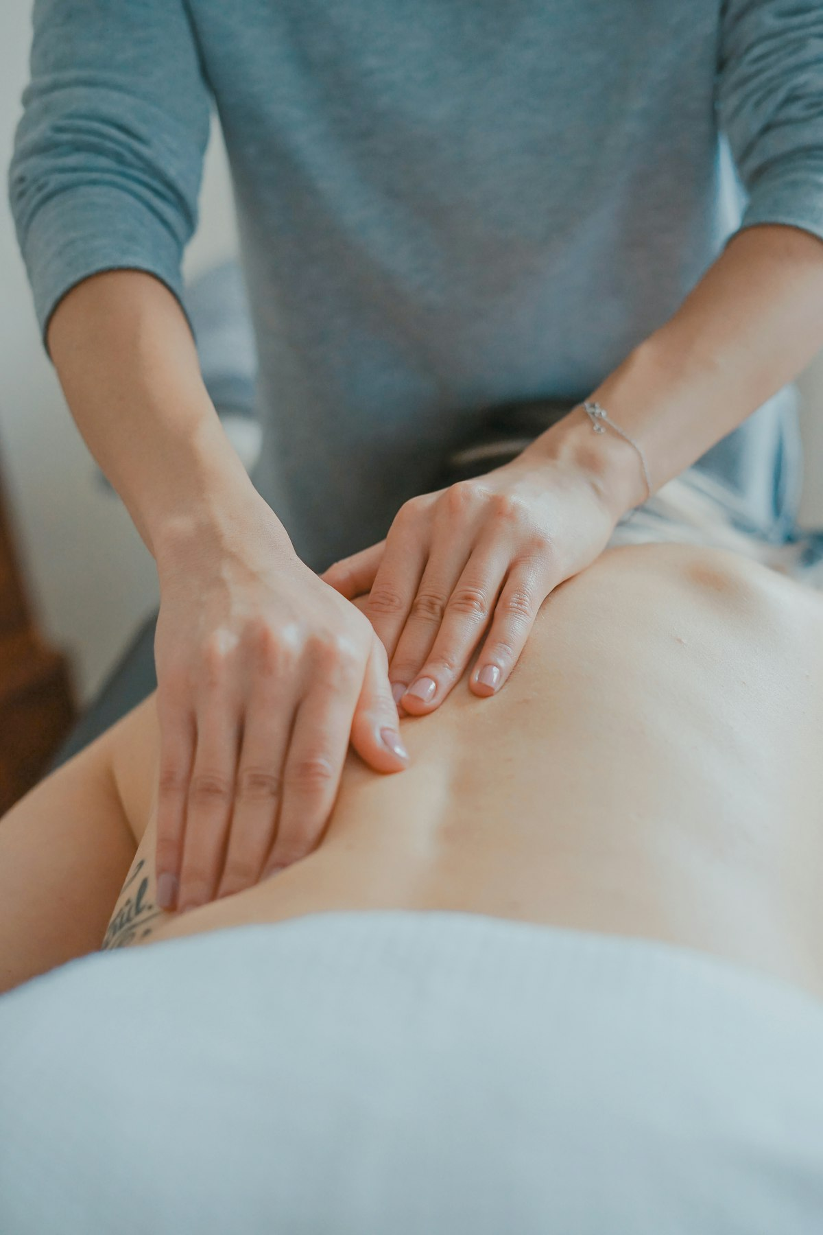
I
MODULE ONE
Professional Presence & Communication
How you carry yourself, speak, and listen — before, during, and after service.
Notes:
Module one. We begin with you — the presence you bring before a single word is spoken.

Slide 6
COMMUNICATION
Luxury Language
A warm, welcoming tone from the first greeting
Polished phrasing — “my pleasure,” “of course,” “right away”
A calm pace and a lowered, unhurried voice
Use the guest’s name; never speak over them
Notes:
Luxury language is warm, never scripted. Trade casual fillers for polished phrasing. Model the difference out loud.

Slide 7
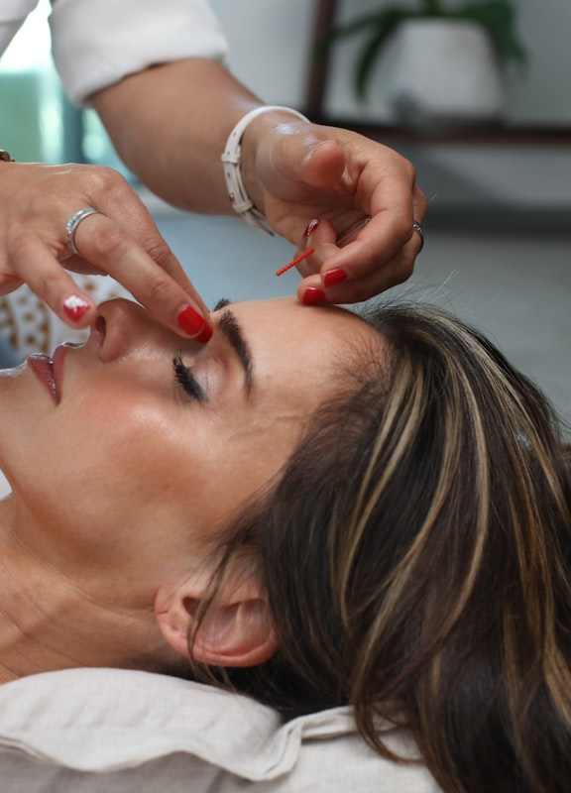
COMMUNICATION
Non-Verbal Presence
Upright, open posture — composed, never rushed
Impeccable grooming and a clean, pressed uniform
Soft eye contact and a genuine, easy smile
Quiet hands, quiet movement, quiet space
Notes:
Most of the message is non-verbal. Grooming and posture say 'you are in expert hands' before you speak.

Slide 8
THE GUEST JOURNEY
Guest Interaction Standards
Before
During
After
Greet warmly, confirm the service, and review preferences and pressure.
Check in discreetly, protect modesty, and keep the room serene.
Offer water, share aftercare, and thank them by name as you rebook.
Notes:
Service has three acts, each with its own etiquette. Walk through what excellence looks like at every stage.

Slide 9
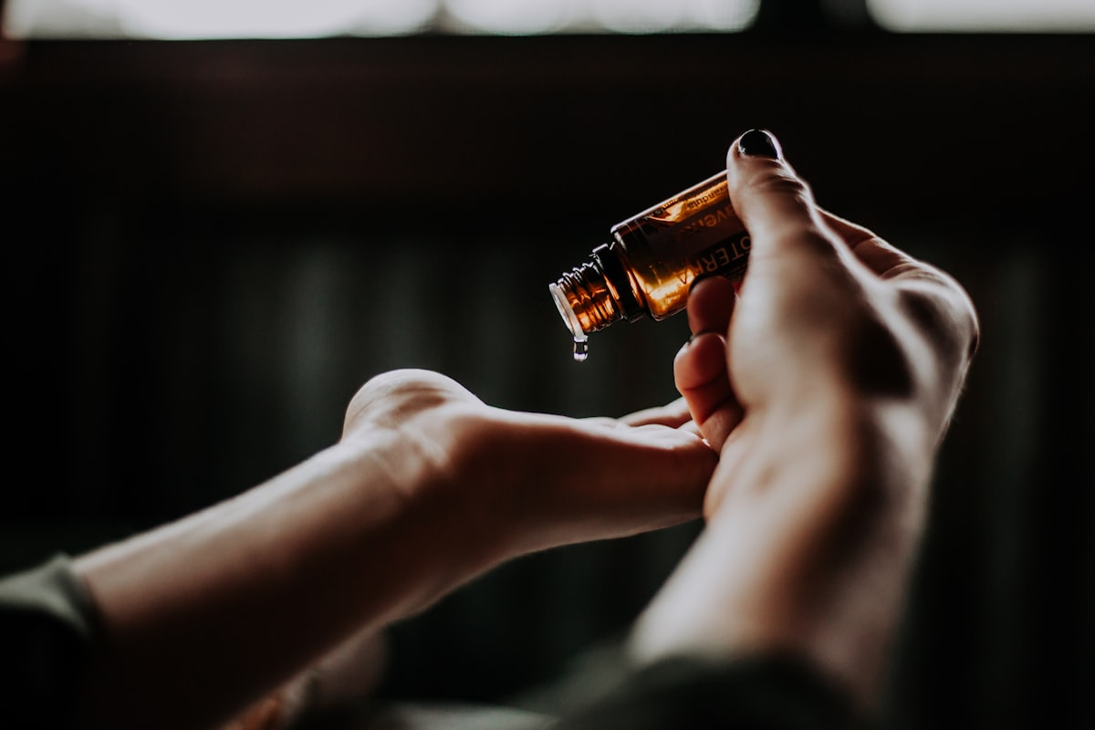
TRUST
Confidentiality & Boundaries
Guest information and conversations remain private
Maintain clear, respectful professional boundaries
Drape correctly and confirm comfort at every step
Notes:
Discretion is non-negotiable. What is shared in the room stays in the room. Boundaries protect guest and therapist alike.

Slide 10
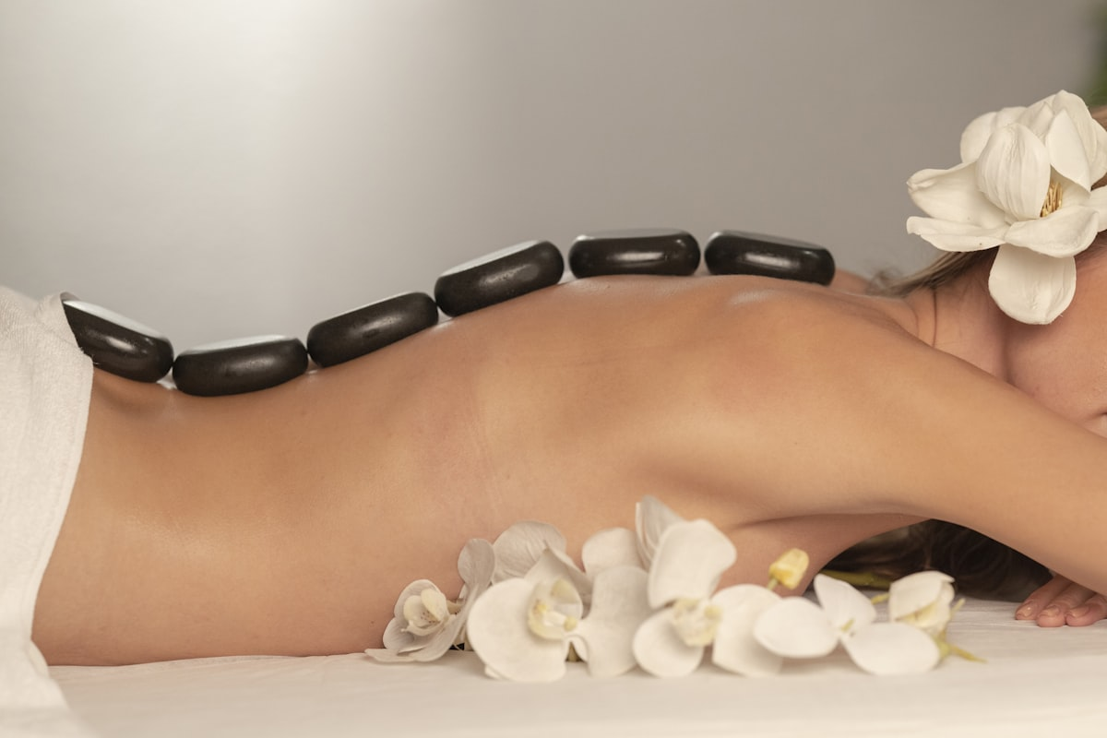
II
MODULE TWO
Treatment Room Etiquette
Preparing and maintaining a space that feels effortless to the guest.
Notes:
Module two. The treatment room is your stage. Its readiness is etiquette made physical.

Slide 11

PREPARATION
Room Readiness
Fresh, crisp linens layered and warmed
Supplies stocked, oils ready, table set
Lighting, music, and temperature dialed in
Surfaces tidy, clutter out of sight
Notes:
A ready room is set before the guest arrives — every time. The guest should never see the work behind the calm.

Slide 12
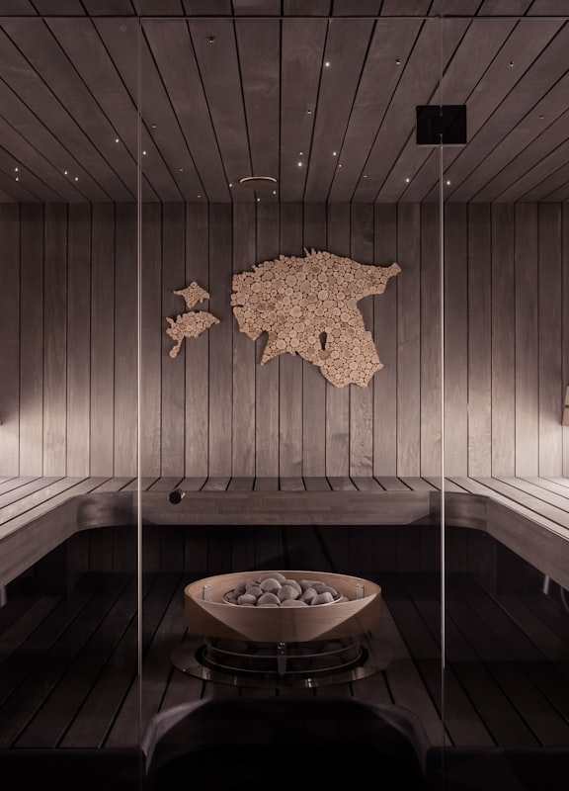
STANDARDS
Safety & Sanitation
Wash and sanitize hands in the guest’s view
Fresh linens for every guest, no exceptions
Disinfect surfaces and tools between sessions
Follow all sanitation protocols precisely
Notes:
Sanitation is etiquette the guest trusts but rarely sees. Visible, consistent hygiene signals respect and safety.

Slide 13
BETWEEN GUESTS
Belongings & the Room Reset
Guest Belongings
The Transition
Offer a secure place for clothing and valuables, and handle every personal item with visible care.
Door closed and privacy protected — reset the room quickly and quietly for the next guest.
Notes:
Two points fused: handle belongings as if precious, and reset the room invisibly and fast between guests.

Slide 14

III
MODULE THREE
Spa Environment & Team Etiquette
The shared spaces and working relationships that hold the experience together.
Notes:
Module three. Etiquette extends beyond the room — into the hallways, back of house, and every colleague.

Slide 15
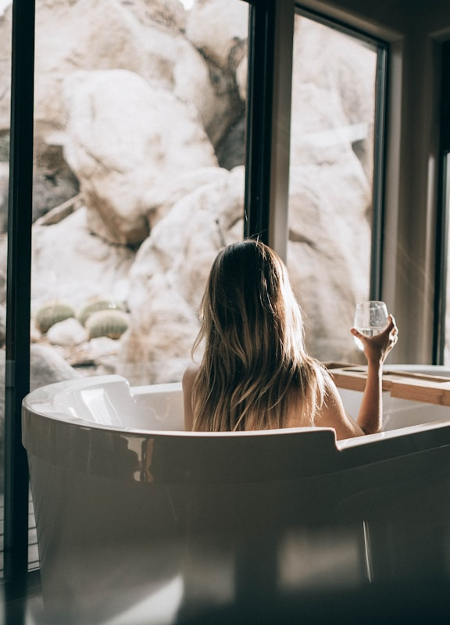
SHARED SPACES
Back-of-House Etiquette
Keep voices low near treatment areas
Leave lockers, supply, and break rooms tidy
Restock what you use for the next therapist
Phones away; presence stays professional
Notes:
The guest's calm depends on the back of house staying calm too. Carry front-of-house standards behind the door.

Slide 16
WORKING TOGETHER
Collaboration & Reporting
With the Team
When to Escalate
Communicate clearly with coordinators and attendants, and support fellow therapists gracefully.
Report concerns to your Lead or Leader on Duty — early, calmly, and through the right channel.
Notes:
You are one node in a team. Coordinators, attendants, and leads keep the floor running. Know how and when to escalate.

Slide 17
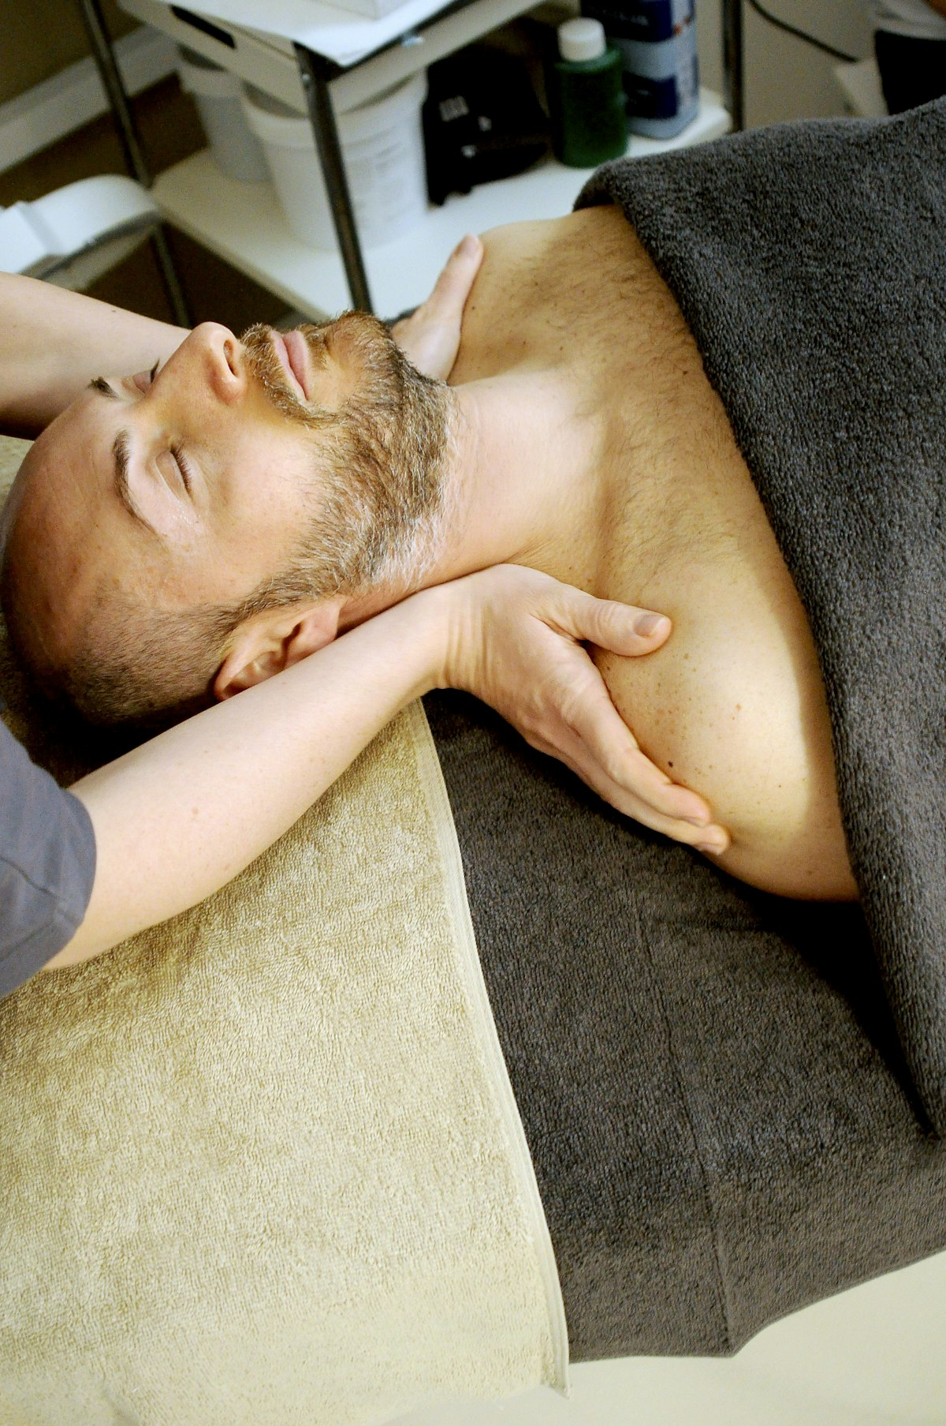
IV
MODULE FOUR
Guest Experience Scenarios
Holding the standard when the situation makes it hard.
Notes:
Module four. Where etiquette is tested: the real, imperfect moments. The heart of today's practice.

Slide 18
UNDER PRESSURE
Handling Challenges
Late Arrivals
Dissatisfaction
Outside Policy
Stay gracious, adjust within policy, and protect the next guest’s time.
Listen fully, acknowledge sincerely, and resolve or escalate calmly.
Decline warmly, offer an alternative, and never compromise safety.
Notes:
Three common pressure points. The etiquette move is the same: acknowledge, stay warm, follow policy, involve a lead when needed.

Slide 19
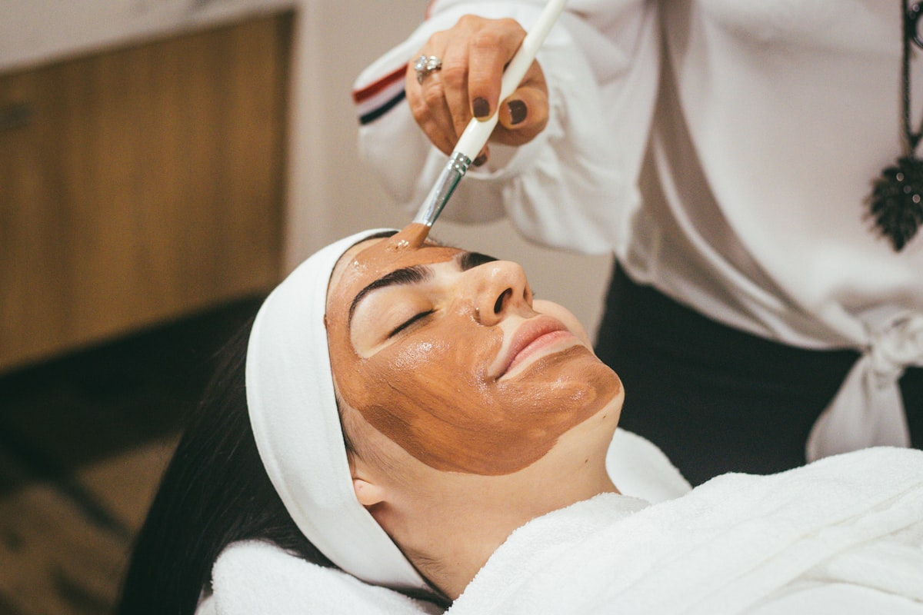
PROFESSIONALISM
Managing Bias with Care
Every guest receives the same warmth and standard of care
Notice personal reactions; set them aside professionally
Let respect, not assumption, guide every interaction
Notes:
Every guest receives the same standard of care. Professionalism means setting personal bias aside, fully and consistently.

Slide 20
CARRY IT FORWARD
The Etiquette Checklist
01
Presence — groomed, composed, warm
02
Language — polished, calm, by name
03
Room — ready, clean, serene
04
Discretion — private, boundaried, safe
05
Team — tidy, supportive, communicative
06
Challenges — gracious, fair, by policy
Notes:
The whole day in one frame — the checklist they carry onto the floor tomorrow.

Slide 21


Every guest, every shift, the same standard of care
You set the tone the moment a guest walks in. Let’s practice.
@SEAISLAND
Notes:
Close on the standard: the same care for every guest, every shift. Transition into the assessment role-play.

